Slide 1
Major Project Review - II :
MCE491P
Title
Name
USN
Guide Name
Professor
RVCE

Slide 2
PRESENTATION CONTENTS
Problem Analysis
Methodology
Design
Introduction and Significance
System Architecture
Structure chart
Flow Chart
Simulation/ Algorithm / Modern tool usage
Development of Solutions and Implementation

Slide 3
Problem Analysis
Text

Slide 4
Problem Analysis
Text

Slide 5
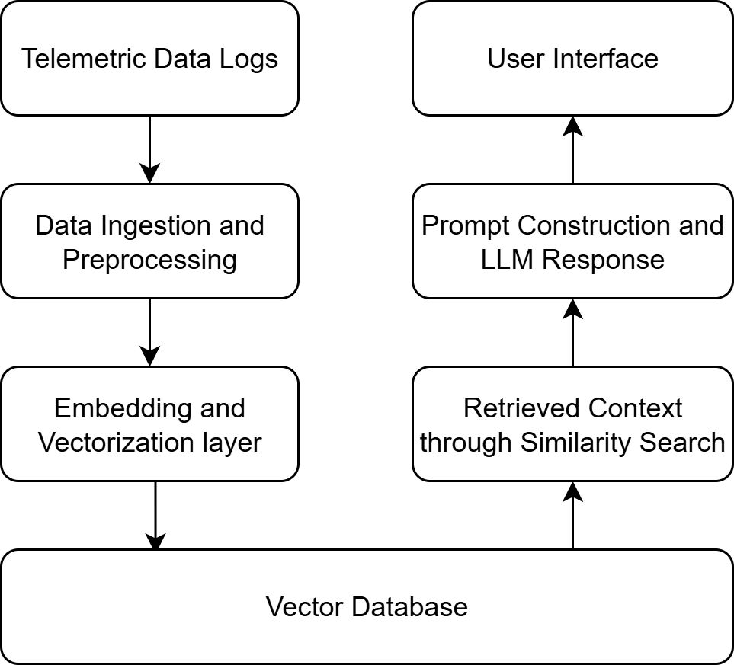
Design: System Architecture
System Architecture

Slide 6
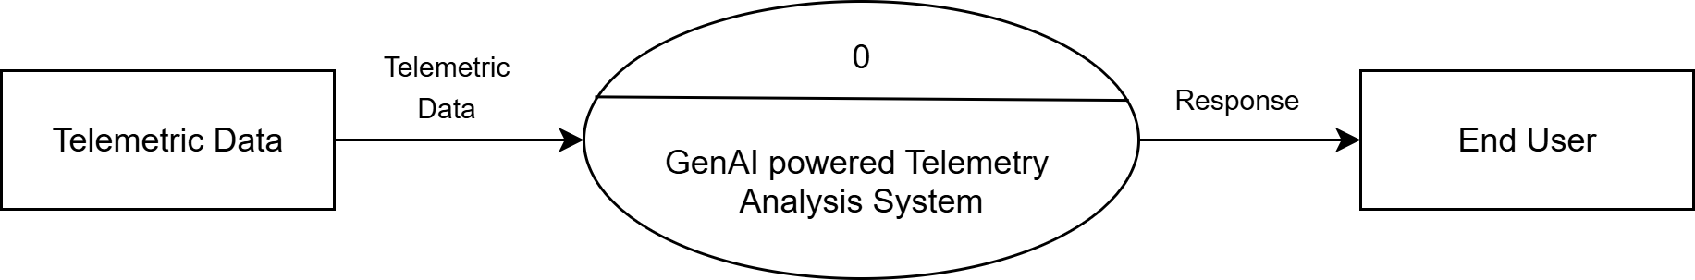
Design: DFD 0
Data Flow Diagram - Level 0

Slide 7
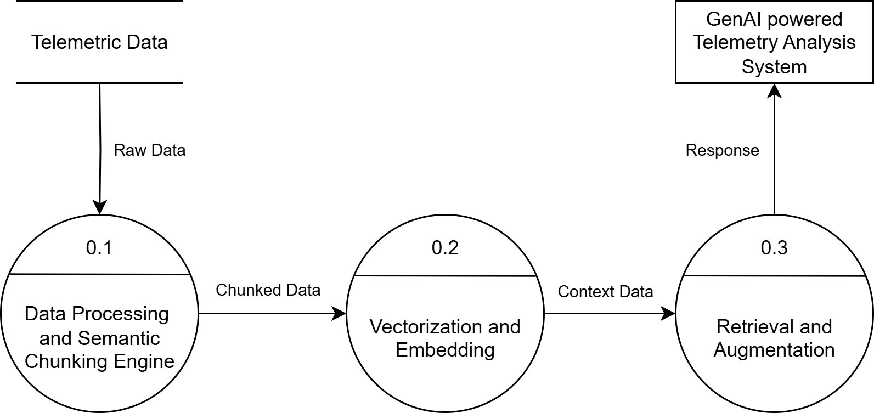
Design: DFD 1
Data Flow Diagram - Level 1

Slide 8
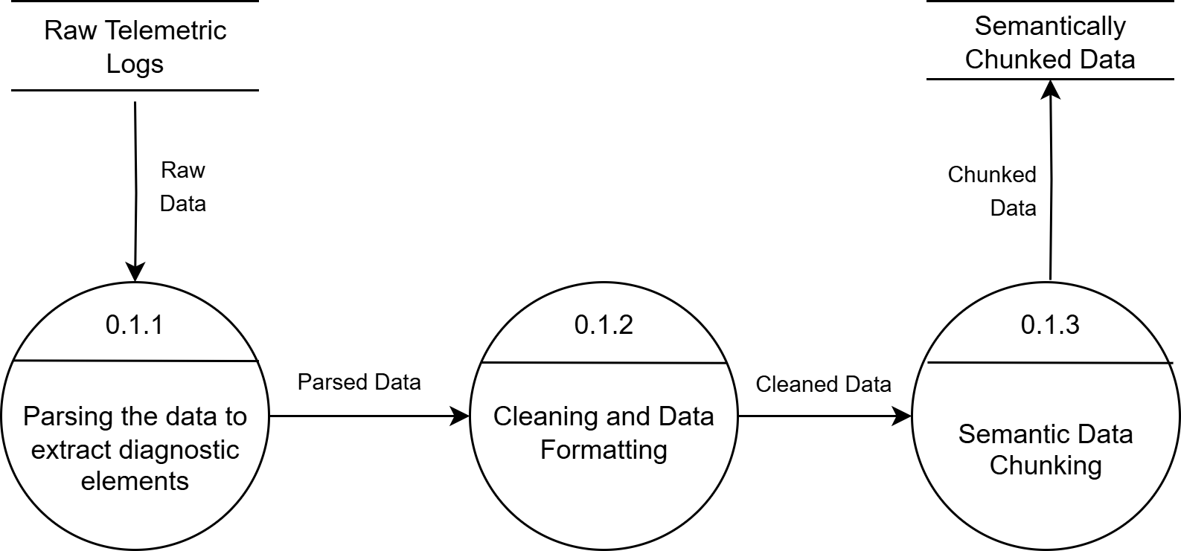
Design: DFD 2
Data Flow Diagram - Level 2

Slide 9
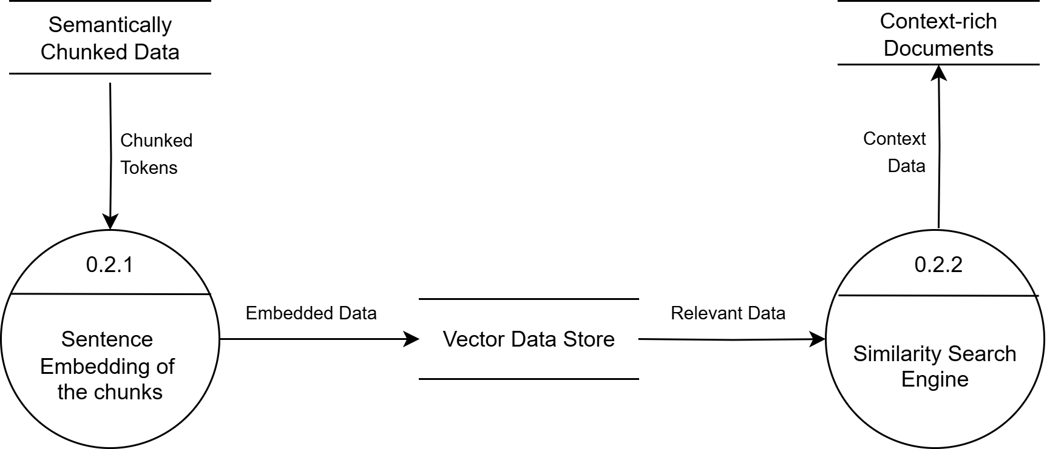
Design: DFD 2
Data Flow Diagram - Level 2

Slide 10
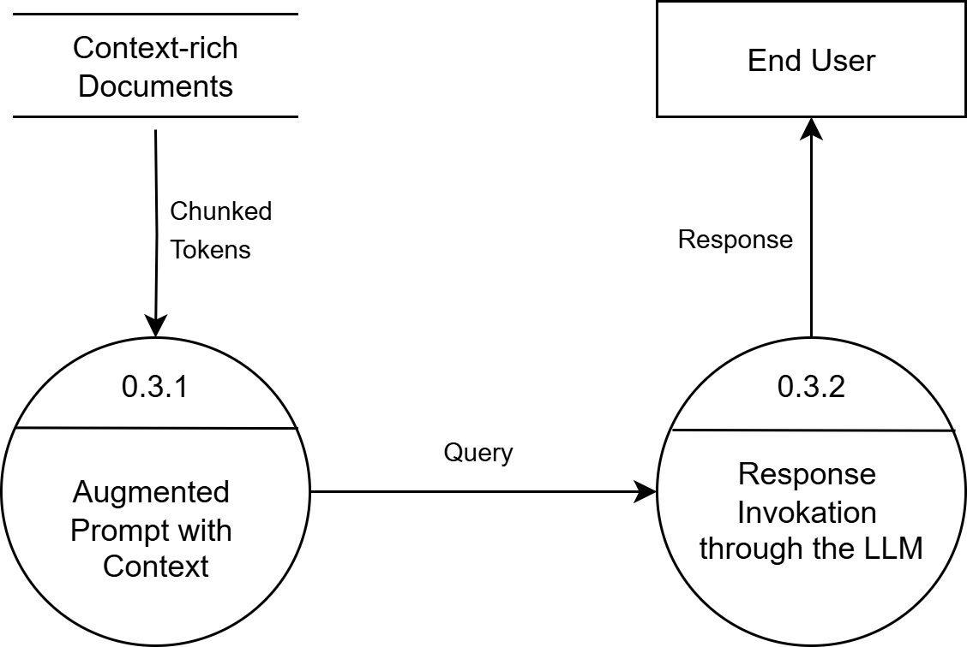
Design: DFD 2
Data Flow Diagram - Level 2

Slide 11
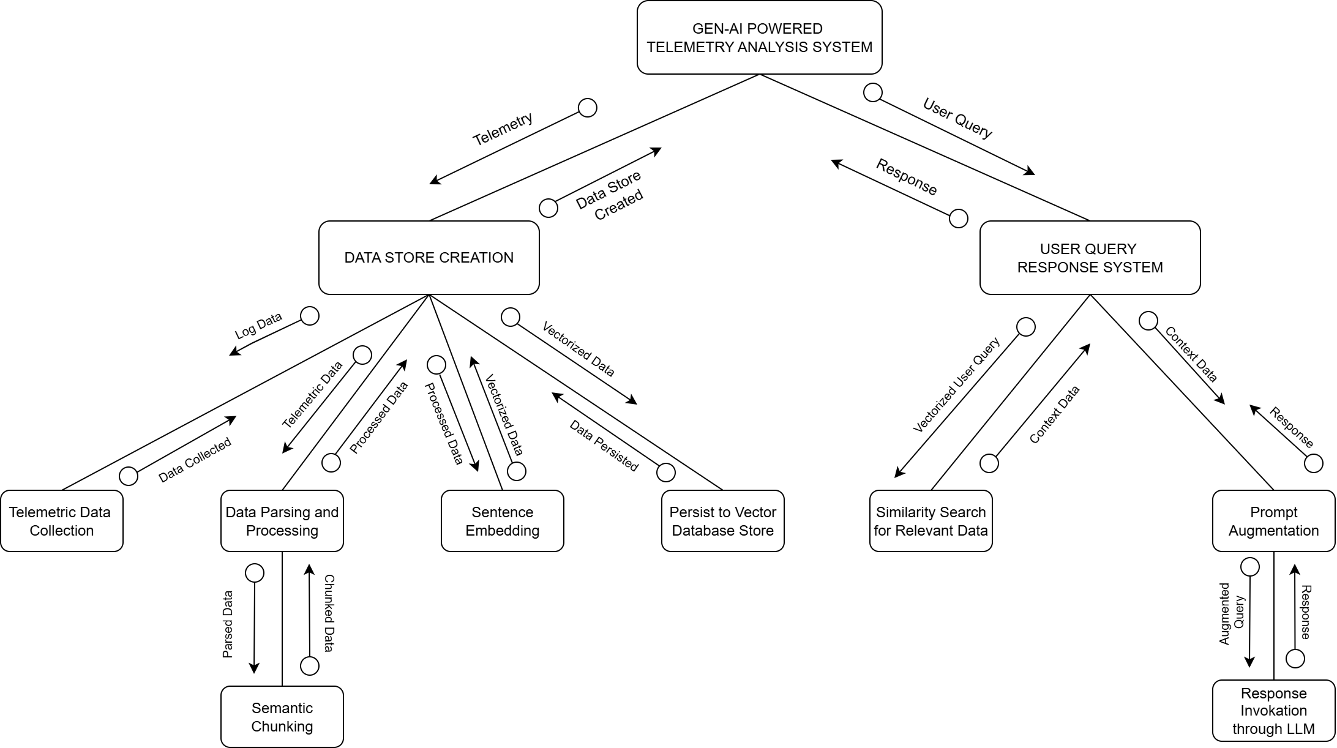
STRUCTURE CHART
Structure Chart

Slide 12
Methodology
Overall Architecture of the Proposed Solution

Slide 13



MODERN TOOL USAGE
GenAI Method | Retrieval Augmented Generation (RAG)
Orchestrator | LangChain and LangGraph
Base Programming Language | Python 3.0
Embedding Model | text-embedding-3-large
Vector Store | ChromaDB
Generative Intelligence | GPT-4o by OpenAI OLLAMA llama3

Slide 14
Draft Paper

Slide 15
References
1.
2.
3.

